Slide 1
Personality Disorders
Long-standing patterns of thought, behavior, and emotions that are maladaptive for the individual or for people around him or her.

Slide 2
Personality
is a set of deeply ingrained, enduring patterns of thinking, acting, & behaving.

Slide 3
A “healthy personality” means:
Maintaining healthy relationships
Experiencing intimacy while maintaining own separate identity
Maintaining a continuum of dependent and independent behavior

Slide 4
Adaptive responses
Solitude
Autonomy
Mutuality
Interdependence

Slide 5
Maladaptive responses
Manipulation
Impulsivity
Narcissism

Slide 6
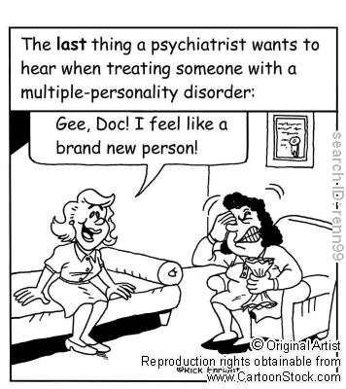
Clinical Features
General symptoms of a personality disorder
Frequent mood swings
Stormy relationships
Social isolation
Angry outbursts
Suspicion and mistrust of others
Difficulty making friends
A need for instant gratification
Poor impulse control
Alcohol or substance abuse

Slide 7
Personality disorders (characteristics)
Chronic, maladaptive social responses
Can be associated with depression, substance abuse, and suicide.

Slide 8
Overview of Clusters

Slide 9
DSM-IV-TR Personality Disorders
Cluster A: Odd-Eccentric Personality Disorders | Symptoms similar to those for schizophrenia, including inappropriate or flat affect, odd thought and speech patterns, paranoia. People with these disorders maintain their grasp on reality, however.
Cluster B: Dramatic Emotional Personality Disorders | Manipulative, volatile, and uncaring in social relationships. Impulsive, sometimes violent behavior that show little regard for their own safety or the safety or needs of others
Cluster C: Anxious-Fearful Personality Disorders | Extremely concerned about being criticized or abandoned by others and thus have dysfunctional relationships with them.

Slide 10
Cluster A: The Odd-Eccentric Personality Disorders
Paranoid personality disorder Chronic and pervasive mistrust and suspicion of other people that is unwarranted and maladaptive.
Schizoid personality disorder Chronic lack of interest in and avoidance of interpersonal relationships, emotional coldness toward others.
Schizotypal personality disorder Chronic pattern of inhibited or inappropriate emotion and social behavior, aberrant cognitions, disorganized speech.
Weak
Relationship to Schizophrenia
Strong

Slide 11
Cluster A Personality Disorders
Paranoid: “People will eventually hurt me.” “People cannot be trusted.”
Schizoid: “Why should I be close to people?” “I am my own best friend.”
Schizotypal: “I am defective.” Relationships are threatening.”

Slide 12
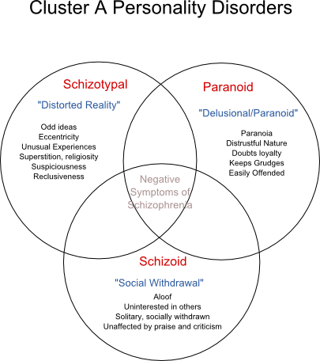
CLUSTER A – Odd Eccentric Type

Slide 13
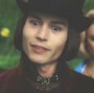
Schizotypal Personality Disorder
peculiar patterns of thinking and behaviour
perceptual and cognitive disturbances
magical thinking
not psychotic
perhaps a distant “cousin” of schizophrenia

Slide 14
Schizotypal PD Description
SELF-VIEW:
Outsider, defective
VIEW OF OTHERS:
Strange, scary, yet desire for social contact
BELIEFS:
Core beliefs: “I do not fit in”, “I must protect myself from threats”
There are reasons for everything. Things don't happen by chance
THREAT:
World (don’t understand)
STRATEGY:
Social isolation
Retreat into delusional ideas
AFFECT:
Anxiety, Depression

Slide 15
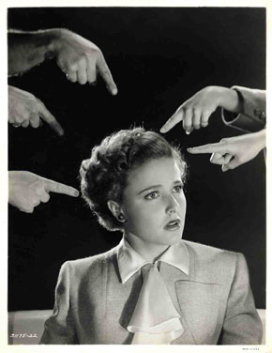
Paranoid personality disorder
A pervasive distrust and suspiciousness of others without sufficient basis
Person persistently bears grudges (unforgiving)
Person is preoccupied with unjustified doubts about the loyalty of friends
Person exhibits feelings of inadequacy

Slide 16
Paranoid PD Description
SELF-VIEW:
Vulnerable
VIEW OF OTHERS:
Adversaries
BELIEFS:
Core beliefs: The world is threatening and I must protect myself
I can only rely on myself, no one else
THREAT:
EVERYONE!!!!!
STRATEGY:
Don’t trust anyone, social isolation
AFFECT:
Hostile, anxious, dysphoric

Slide 17
Schizoid PD
D – Detached affect
I – Indifferent to praise or criticism
S – Sexually uninterested
T – Tasks done solitarily
A – Absence of close friends
N – Neither desire nor enjoys close relationship
T – Takes pleasure in few activities

Slide 18
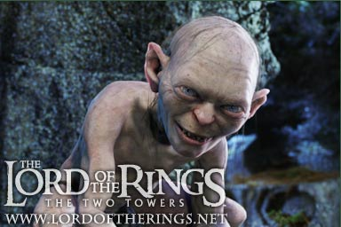
Schizoid PD Description
SELF-VIEW:
Different, Empty
VIEW OF OTHERS:
More trouble than worth, impediment to freedom
BELIEFS:
Core beliefs are "Relationships are problematic ," "Life is less complicated without other people ”
I need plenty of space
THREAT:
Compliance, complications
STRATEGY:
Isoloation
AFFECT:
Flat (not to be confused with depressed)

Slide 19
Cluster B: Dramatic Emotional Personality Disorders
Antisocial personality disorder | Pervasive pattern of criminal, impulsive, callous, or ruthless behavior; disregard for rights of others; no respect for social norms. One of the most common of the personality disorders and one of the most difficult to treat.
Borderline personality disorder | Rapidly shifting and unstable mood, self-concept, and interpersonal relationships; impulsive.
Histrionic personality disorder | Rapidly shifting moods, unstable relationships, and intense need for attention and approval; dramatic, seductive behavior.
Narcissistic personality disorder | Grandiose thoughts and feelings of one’s own worth; obliviousness to others’ needs.

Slide 20
Antisocial PD Description
SELF-VIEW:
Superior, unconcerned
VIEW OF OTHERS:
Suckers, inferior, means to an end
BELIEFS:
Core beliefs are “People are there to be taken," "If I want something, I should do whatever is necessary to get it ”
If people can't take care of themselves, that's their problem
I can get away with things so I don't need to worry about bad consequences
THREAT:
???
STRATEGY:
Take what you want.
AFFECT:
Irritability, anger when blocked from goals.

Slide 21
Cluster B: Dramatic, Emotional, or Erratic Personality Disorders
Borderline: A pattern of instability in, self-image, interpersonal relationships, and affect, and marked impulsivity.

Slide 22
Borderline PD Description
SELF-VIEW:
Unstable and fragmented, helpless, victims
VIEW OF OTHERS:
The cause of and answer to all life’s problems
BELIEFS:
Core beliefs are “I am unlovable," "No one is ever there to meet my needs, to be strong for me, to care for me ”
I can't cope on my own. I need someone to rely on
THREAT:
Abandonment
STRATEGY:
Demand love, test love
AFFECT:
Anger, Depression, Anxiety

Slide 23
Cluster B – Borderline

Slide 24
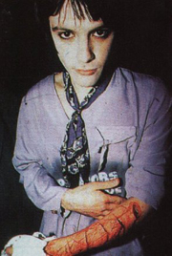
Borderline PD
Associated Features:
Up to 10% of persons with BPD eventually die by their own hand
High co-morbidity with Mood Disorders
Marked mood shifts, unpredictable
Undermining one’s own success
some symptoms may improve by midlife
Over 50% report childhood maltreatment

Slide 25
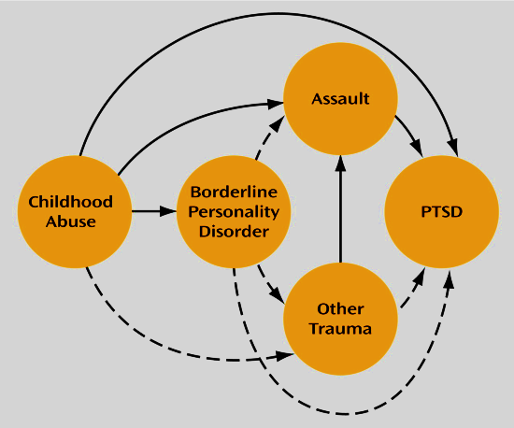
Cluster B – Borderline

Slide 26
Mnemonic for Histrionic PD (5/8)
P - provocative (or seductive) behavior
R - relationships, considered more intimate than they are
A - attention, must be at center of
I - influenced easily
S - speech (style) - wants to impress, lacks detail
E - emotional lability, shallowness
M - made-up (physical appearance get attention)
E - exaggerated emotions (theatrical)

Slide 27
Histrionic PD Description
SELF-VIEW:
???
VIEW OF OTHERS:
Objects to be won over
BELIEFS:
Core beliefs are “In order to be happy I need other people to pay attention to me ," "Unless I entertain or impress people, I am nothing ”
It is awful for people to ignore me
THREAT:
Being ignored, forgotten
STRATEGY:
Entertain, draw attention to self
AFFECT:
Anxiety, depression when ignored

Slide 28
Histrionic Personality Disorder
excessive emotional displays/ dramatic behaviour
attention-seeking, victim stance
seek re-assurance, praise
shallow emotions, flamboyant, self-centred
very seductive, “life of the party”

Slide 29
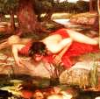
Narcissistic Personality Disorder
grandiose, sense of self-importance
lack of empathy
hyper-sensitive to criticism
exaggerate accomplishments/ abilities
special and unique
entitlement
below surface is fragile self-esteem

Slide 30
Narcissistic PD Description
SELF-VIEW:
Superior, special
VIEW OF OTHERS:
“less equal”, servants, threat
BELIEFS:
Core beliefs are “I am special and other people should recognize how special I am," "No one's needs should interfere with my own ”
It's intolerable if I'm not accorded my due respect or don't get what I'm entitled to
THREAT:
Being average (narcissistic facade?)
STRATEGY:
Demand special treatment, begrudge others
AFFECT:
Anger

Slide 31
Cluster C: The Anxious-Fearful Personality Disorders
Avoidant personality disorder
Pervasive anxiety, a sense of inadequacy, and a fear of being criticized, which leads to the avoidance of social interactions and nervousness.
Dependent personality disorder: Pervasive selflessness, need to be cared for, fear of rejection, leading to total dependence on and submission to others.
.
Obsessive-compulsive personality disorder Pervasive rigidity in one’s activities and interpersonal relationships, including emotional construction, extreme perfectionism, and anxiety about even minor disruptions in one’s routine.

Slide 32
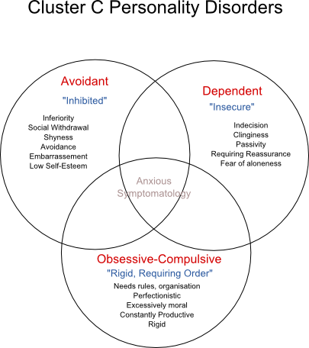
Cluster C – Anxious and Fearful Type

Slide 33
Avoidant Personality Disorder
over-riding sense of social discomfort
easily hurt by criticism
always need emotional support
occasionally try to socialize
so distressing they retreat into loneliness

Slide 34
Avoidant PD Description
SELF-VIEW:
Socially inept and incompetent in academic and/or work situations
VIEW OF OTHERS:
Potentially critical, uninterested, and demeaning
BELIEFS:
Core beliefs: I am no good...worthless...unlovable. I cannot tolerate unpleasant feelings
If people got close, they would discover the 'real me' and reject me--that would be intolerable . It is best to stay clear of risky involvement
THREAT:
Rejection, demeaned, humiliation, “found out”
STRATEGY:
Avoid, Avoid, Avoid
AFFECT:
Dysphoria – anxiety and sadness

Slide 35
Dependent PD Description
SELF-VIEW:
Needy, weak, helpless and incompetent
VIEW OF OTHERS:
Caretakers, protectors, super-competent
BELIEFS:
Core beliefs: I am helpless, I am all alone in the world
I need other people--specifically, a strong person--in order to survive
If I am not loved I cannot be happy
THREAT:
Rejection, abandonment
STRATEGY:
Cultivate relationship, subjugate own needs for “security”
AFFECT:
Anxiety (relations strained), Depression (relation over), Euphoria (relationship good)

Slide 36
OCPD Mnemonic (4/8)
L – Loses point of activity (preoccupation with detail)
A – Ability to complete tasks comprimized (perfectionism)
W – Worthless objects (unable to discard)
F – Friendships excluded (preoccupation with work)
I – Inflexible, overconscientious
R – Reluctant to delegate
M – Miserly (toward self and others)
S – Stubbornness (and rigidity)

Slide 37
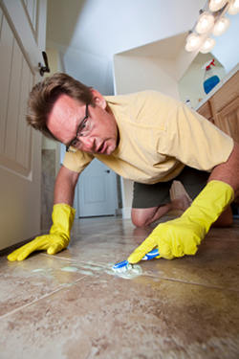
Obsessive Compulsive PD Description
SELF-VIEW:
Responsible for themselves and others . Often core image of selves as inept / helpless
VIEW OF OTHERS:
Too casual, often irresponsible, self-indulgent, or incompetent
BELIEFS:
Core beliefs are "I could be overwhelmed," "I am basically disorganized or disoriented”
If I don't have systems, everything will fall apart
If I fail in this, I am a failure as a person
THREAT:
Flaws, mistakes, disorganization, or imperfections –loss of control
STRATEGY:
Be perfect, control everything.
AFFECT:
Anxiety, irritability – and depression when “failure” occurs

Slide 38
DON’T SHOULD ON YOURSELF!!!!

Slide 39
HOW DO YOU EAT AN ELEPHANT, ONE BITE AT A TIME!

