Slide 1
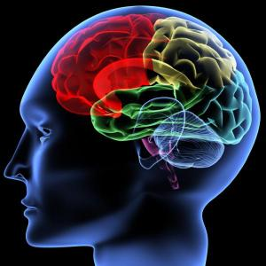
OTHER PSYCHOTIC DISORDERS (apart from Schizophrenia)
By:
Maryam Eshratifar
Saba Mohammad Ghasemi
Medical Students at IAUTMU
March 2014

Slide 2
OTHER PSYCHOTIC DISORDERS
1. Schizophreniform Disorder
2. Schizoaffective Disorder
3. Delusional Disorder
4. Brief Psychotic Disorder
5. Shared Psychotic Disorder
6. Postpartum Psychosis
7. Psychotic Disorder Not Otherwise
Specified
8. Culture-Bound Syndromes

Slide 3
1. Schizophreniform Disorder
Symptoms last at least 1 month &
resolve within 6 months
Prevalence rate of 0.2%, mostly in
adolescents and young adults
Patients have more mood symptoms
and better prognosis, often occurs in
families of patients with mood
disorders.

Slide 4
DSM-IV-TR Diagnostic Criteria for Schizophreniform Disorder *
A. Criteria A, D and E of schizophrenia are met.
B. An episode of the disorder (including prodromal, active and residual phases) lasts at least 1 month but less than 6 months.
(When the diagnosis must be made without waiting for recovery, it should be qualified as “provisional”.)
Specify if:
Without good prognostic features.
With good prognostic features: as evidenced
by two or more of the following:
1- onset of prominent psychotic symptoms within 4 weeks
of the first noticeable change in usual behavior or
functioning
2- confusion or preplexity at the height of the psychotic
episode
3- good premorbid social and occupational functioning
4- absence of blunted or flat affect

Slide 5
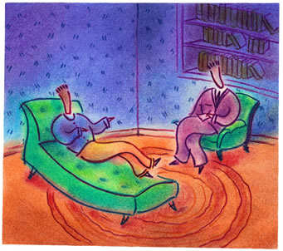
DDx:
1- Schizophrenia: is diagnosed if the duration of prodromal, active and residual
phases lasts for more than 6 months.
2- Brief psychotic disorder: Symptoms occur for less than 1 month and a major
stressor need not be present.
3- Mood and anxiety disorders: a thorough longitudinal history is important in
elucidating the diagnosis.
4- Substance-induced psychosis
5- Psychosis due to a medical condition
Prognosis:
Good prognostic features: No blunted or flat affect, confusion & disorientation at the height of the psychotic episode, shorter duration, acute onset
Treatment:
Antipsychotic medications
Psychotherapy
Electroconvulsive therapy (ECT)

Slide 6
2. Schizoaffective Disorder
With concurrent features of both schizophrenia & mood disorder that cannot be diagnosed as either one separately.
Life time prevalence is less than 1%
women > men
Some patients maybe misdiagnosed: they are actually schizophrenic with prominent mood symptoms or have a mood disorder with prominent psychotic symptoms

Slide 7
DSM-IV-TR Diagnostic Criteria for Schizoaffective Disorder *
An uninterrupted period of illness during which, at some time, there is either a major depressive episode, a manic episode, or a mixed episode concurrent with symptoms that meet criterion A for schizophrenia.
Note: The major depressive episode must include criterion A₁: depressed mood
B. During the same period of illness, there have been delusions or hallucinations for at least 2 weeks in the absence of prominent mood symptoms.
C. Symptoms that meet criteria for a mood episode are
present for a substantial portion of the total duration of
the active and residual periods of the illness.
D. The disturbance is not due to the direct physiologic
effects of a substance (e.g. a drug of abuse, a
medication) or a general medical condition.
Specify type:
Bipolar type: if the disturbance includes a manic or
a mixed episode (or a manic or a mixed episode and major
depressive episodes)
Depressive Type: if the disturbance only includes major
depressive episodes

Slide 8
DDx:
Any medical, psychiatric, or drug related
condition that causes psychotic or mood symptoms must be considered
Prognosis:
Poor prognostic features:
Positive family history of schizophrenia
Early and insidious onset without precipitating factors
Predominance of psychotic symptoms
Treatment:
Antidepressant or antimanic
treatments + antipsychotic medications
Electroconvulsive therapy (ECT) in manic cases
Family therapy, social skills training and
cognitive rehabilitation

Slide 9
3. Delusional Disorder
Primary or sole manifestation is a non-bizarre delusion which is fixed and unshakable.
Only 1 to 2% of all mental health admissions
Mean age of onset is about 40 years old
Primarily psychosocial in origin. Common background characteristics include a history of physical or emotional abuse, cruel and unreliable parenting, social isolation and loneliness, … .

Slide 10
DSM-IV-TR Diagnostic Criteria for Delusional Disorder *
Non-bizarre delusions (i.e. involving situations that occur in real life, such as being followed, poisoned, infected, loved at a distance, or deceived by spouse or lover, or having a disease) of at last 1 month’s duration.
Criterion A for schizophrenia has never been met. Note: Tactile and olfactory hallucination may be present in delusional disorder if they are related to the delusional theme.
Apart from the impact of the delusion(s) or its ramifications, functioning is not markedly impaired and behavior is not obviously odd or bizarre.
D. If mood episodes have occurred concurrently with delusions,
their total duration has been brief relative to the duration of the
delusional periods.
E. The disturbance is not due to the direct physiological effects of a
substance (e.g. a drug of abuse, a medication) or a general
medical condition.
Specify type (based on the predominant delusional theme):
Erotomanic Type: delusion that another person usually of higher status is inlove
with the individual.
Grandiose Type: delusions of inflated worth, power, knowledge, identity, or special
relationship to a famous person.
Jealous Type: delusions that the individual’s sexual partner is unfaithful
Persecutory Type: delusions that the person is being malevolently treated.
Somatic Type: delusions that the person has some general medical conditions.
Mixed Type: delusions characteristic of more than one of the above types, but no
one theme predominates.
Unspecified Type

Slide 11
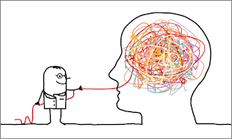
DDx:
1- Psychotic disorder resulting from general medical condition
with delusions.
2- Substance-induced psychotic disorder with delusions.
3- Paranoid personality disorder
4- Paranoid schizophrenia
5- Major depressive disorder
6- Bipolar I disorder
Prognosis:
Good prognostic features:
High levels of occupational, social and functional adjustments
Female sex
Onset before age 30 years
Sudden onset, Short duration of illness
Treatment:
Hospitalization
Psychopharmacotherapy
( antipsychotics & antidepressants )
Psychotherapy

Slide 12
4. Brief Psychotic Disorder
Transient psychotic syndrome in which symptoms last for less than 1 month and follow a severe and obvious stress in the patient’s life.
Onset is usually between 20 and 35 years of age.
More frequent in persons with pre-existing personality disorders or previously experienced major stressors such as disasters or dramatic cultural changes.

Slide 13
DSM-IV-TR Diagnostic Criteria for Brief Psychotic Disorder *
Presence of one or more of the following symptoms.
1. Delusions
2. Hallucinations
3. Disorganized speech
Note: do not include a symptom if it is a culturally sanctioned response pattern.
B. Duration of an episode of the disturbance is at least I day but less than 1 month, with eventual full return to premorbid level of functioning.
C. The disturbance is not better acconted for by a mood disorder with psychotic
features, schizoaffective disorder, or schizophrenia and is not
due to the direct psychological affects of a substance (drug of
abuse, a medication) or a general medical condition.
Specify if:
With marked stressor(s) (brief reactive psychosis): if symptoms occur
shortly after and apparently in response to events that, singly or together,
would be markedly stressful to almost anyone in similar circumstances in
the person’s culture
Without marked stressor(s): if psychotic symptoms do not occur shortly
after, or are not apparently in response to events that, singly or together,
would be markedly stressful to almost anyone in similar circumstances in the
person’s culture
With postpartum onset: if onset within 4 weeks postpartum

Slide 14
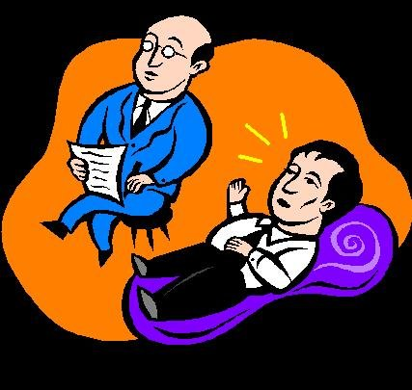
DDx:
1- Medical causes must be ruled out – in particular, drug intoxication
and withdrawal.
2- Seizure disorders
3- Factitious disorders, malingering
4- Transient psychotic episodes associated with borderline and
schizotypal personality disorders .
Prognosis:
By definition, course of disorder is
less than 1 month. Recovery is up to
80% with treatment.
Treatment:
Hospitalization
Pharmacotherapy (antipsychotic drugs +
Benzodiazepines)
Psychotherapy ( Family involvement in
the treatment process maybe crucial to a
successful outcome).

Slide 15
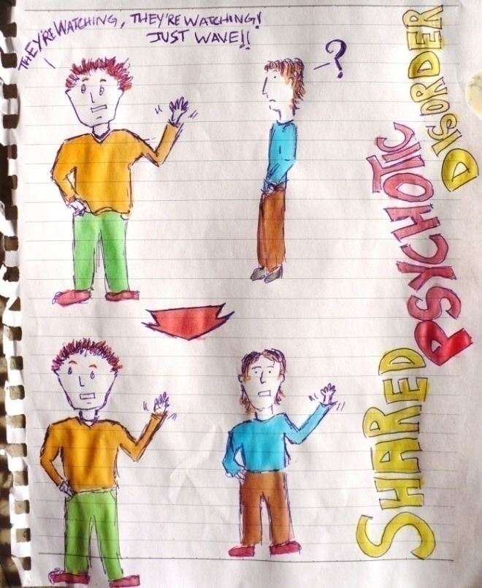
5. Shared Psychotic Disorder
Delusional system shared by two or more persons
Previously called induced paranoid disorder and folie á deux
More common in:
* Women
* Persons with physical
disabilities that make
them dependent on
another person.

Slide 16
DSM-IV-TR Diagnostic Criteria for Shared Psychotic Disorder *
A delusion develops in an individual in the context of a close relationship with another person(s), who has an already-established delusion.
B. The delusion is similar in content to that of the person who already has the established delusion.
C. The disturbance is not better accounted for by another psychotic disorder (e.g. schizophrenia) or a mood disorder with psychotic features and is not due to the direct psychological effects of a substance (e.g. a drug of abuse, a medication) or a general medical condition.

Slide 17
DDx:
1- Personality disorder
2- Malingering
3- Factitious disorders
4- Medical causes must always be considered
Prognosis:
Traditionally the submissive partner
is separated from the dominant,
psychotic partner, with the ideal
outcome being a rapid diminution in
the psychotic symptoms
Treatment:
Separate the persons and help the more
submissive, dependent partner develop
other means of support to compensate
for the loss of the relationship.
Antipsychotic medications

Slide 18
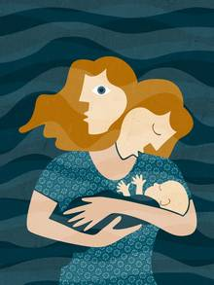
6. Postpartum Psychosis
Syndrome occurring after childbirth
characterized by severe depression and delusions
Incidence 1 to 2 per 1000 childbirths
Usually secondary to underlying
mental illness (e.g. schizophrenia,
bipolar disorder)

Slide 19
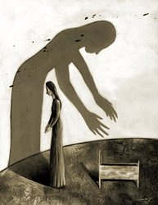
Dx:
Most cases occur 2 to 3 days postpartum
Initial complaints:
Insomnia
Restlessness
Irrationality
Delusions
Obsessive concerns about the infant
Emotional liability progress to confusion
**Thoughts of wanting to harm the baby
or self are characteristic**

Slide 20
DDx:
1- Postpartum blues: Most women experience postpartum
emotional lability. Clears spontaneously. No evidence of
psychotic thinking.
2- Substance-induced mood disorder: Depression associated
with post anesthetic states, such as after cesarean section.
3- Psychotic disorder resulting from general medical condition:
R/O infection, hormonal imbalance, preeclampsia.
Prognosis:
Good prognosis associated with: supportive family
network and
appropriate treatment.
**Risk of infanticide, suicide or both are high in untreated cases**
Treatment:
Pharmacologic: antidepressants + antianxiety
+ antipsychotic
Psychological: Individual and
marital psychotherapy

Slide 21
7. Psychotic Disorder Not Otherwise Specified
Patients whose psychotic presentation does not meet the diagnostic criteria for any established psychotic disorder
Also known as atypical psychosis

Slide 22
DSM-IV-TR Diagnostic Criteria for Psychotic Disorder Not Otherwise Specified*
This category includes psychotic symptomatology (i.e. delusions, hallucinations, disorganizes speech, grossly disorganizes or catatonic behavior) about which there is inadequate information to make a specific diagnosis or about which there is contradictory information, or disorders with psychotic symptoms that do not meet the criteria for any specific psychotic disorder.
Examples include:
1- Postpartum psychosis that does not meet criteria for mood disorder with psychotic
features, brief psychotic disorders, psychotic disorder due to a general
medical condition, or substance-induced psychotic disorder.
2- Psychotic symptoms that have lasted for less than 1 month but
that have not yet remitted, so that the criteria for brief psychotic
disorder are not met.
3- Persistent auditory hallucinations in the absence of any other
features.
4- Persistent nonbizarre delusions with periods of overlapping
mood episodes that have been present for a substantial portion
of the delusional disturbance.
5- Situations in which the clinician has concluded that a
psychotic disorder is present, but is unable to determine
whether it is primary, due to a general medical condition, or
substance induced.

Slide 23
Signs & Symptoms:
1- Autoscopic psychosis:
Rare hallucinatory psychosis during which the patient sees a phantom or
specter of his or her own body. Maybe psychogenic in origin, but
consider lesion of temporoparietal lobe. Responds to antipsychotic
medications.
2- Capgras’ syndrome: Delusion that persons in the
environment are not their real selves but are doubles imitating the
patient or impostors imitating someone else. Maybe part of
schizophrenia or cerebral lesions. Treat with antipsychotic
medications and psychotherapy.
3- Cotard’s syndrome: Delusions of nihilism (e.g. nothing
exists, the body has disintegrated, the world is coming to an
end). Usually seen as part of schizophrenia or severe
bipolar disorder. Maybe an early sign of Alzheimer’s
disease or other cerebral lesion. May respond to
antipsychotic or antidepressant medications.

Slide 24
8. Culture-Bound Syndromes
Examples of Common Culture-Bound Syndromes*:
Syndrome | Region/Population Affected | Description
Amok | Malaysia | Dissociative episode characterized by a period of brooding followed by an outburst of violent, aggressive or homicidal behavior.
Arctic Hysteria | Alaska Natives | Abrupt dissociative episode accompanied by extreme excitement and frequently followed by convulsive seizures and coma.
Ataque de Nervios | Latin America | Symptoms include uncontrollable shouting, attacks of crying, trembling, heat in the chest rising to the head, and verbal or physical aggression.
Brain Flag | West Africa | Symptoms include difficulties in concentrating, remembering and thinking.

Slide 25
Examples of Common Culture-Bound Syndromes*:
Syndrome | Region/Population Affected | Description
Koro | Malaysia | Sudden and intense anxiety that the penis will recede into the body and possible cause death.
Mal de Ojo (Evil Eye) | Spain and Latin America | A common idiom to describe disease, misfortune and social disruption.
Windigo | Native Americans Central and N.E. Canada | Morbid state of anxiety with fears of becoming a cannibal.

Slide 26
Reference:
Sadock BJ, Sadock VA. Kaplan and Sadock’s Pocket Handbook of Clinical
Psychiatry. 5th ed. 2010. Chapter 13. Pages 159-174.
* From American Psychiatric Association. Diagnostic and Statistical Manual of Mental Disorders. 4th ed. Text
rev. Washington, DC: American Psychiatric Association; 2000. with permission.

